Slide 1
Real-time Emotion and gender classification
11-22-2022
Ayman Fahsi: A20440820
Mouhammad Bazzi: A20522180
CS577 - Fall 2022

Slide 2
Problem statement
The goal of this project is to produce two models that can be applied to a real-time classification pipeline
The two models are a GENDER and an EMOTION classifier
We want low computation costs and a high classification accuracy

Slide 3
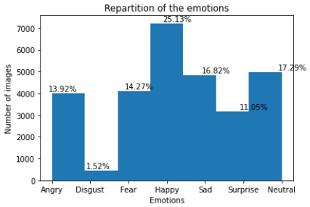

Proposed solution
Data Sets
GENDER CLASSIFIER
IMDB Faces Data Set
-
460,723 color images
{“Woman”, “Man”, Ø}
EMOTIONS CLASSIFIER
FER-2013 Data Set
-
28,709 gray-scale images
{“Angry”, “Disgust”, “Fear”, “Happy”, “Sad”, “Surprise”, “Neutral”}

Slide 4
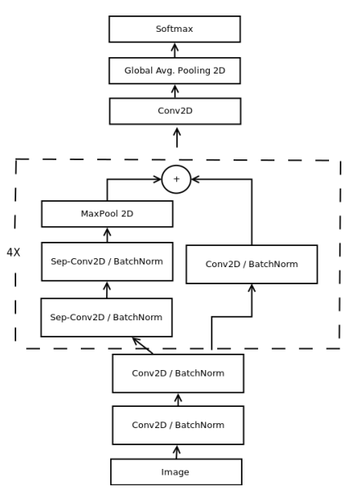
Proposed solution
Models Architectures
2 MODELS
Basic Model
Model that will be used as a reference
Residual Model
Fewer parameters
No Fully Connected Layers
Separable Convolutions
Residual Modules
Residual Model description [1]

Slide 5
PROPOSED SOLUTION
Real-time Pipeline
Webcam/Video File
Haar Cascade Classifier (Face Detection)
Gender Prediction
Emotion Prediction
OpenCV
OpenCV
Our model
Our model

Slide 6
Implementation DETAILS
6
While preprocessing the IMBD dataset, we ran into storage issues and were unable to compile the model locally or through Google Colab
→ We decided to use a subset of the initial data set (less than 15%)
We also had issues with the training time
→ We decided to purchase more computation power (Google Colab Pro)
When we end the main program, Python crash
→ Not really solved (we use the task manager to force the termination of the task)

Slide 7
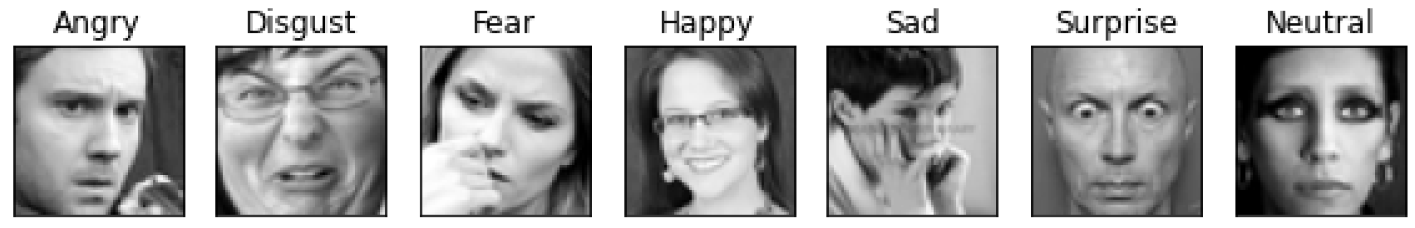
Results & DISCUSSION
Emotion Classification
7

Slide 8
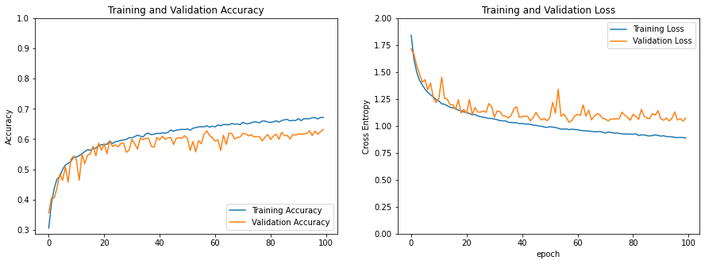
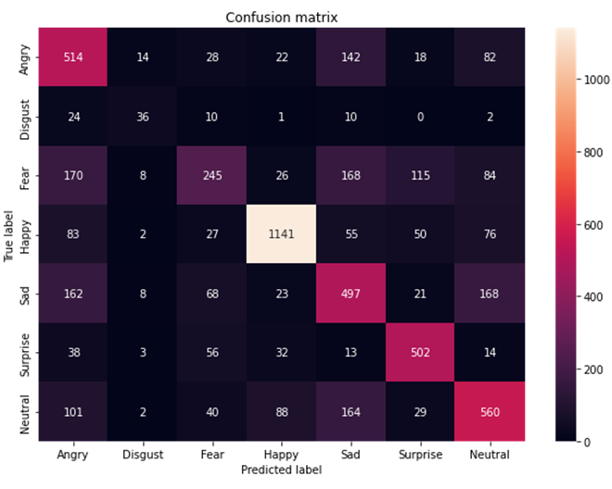
Results & DISCUSSION
Emotion Classification
8
Best Model: 60.86%
(Paper: 66%)

Slide 9
Results & DISCUSSION
Gender Classification
9
ID | Images Number | Percentage of Men labels | Ideal Epoch before overfit | Accuracy on the test set
1 | 12,716 | 59.71% | 3 | 69.56%
2 | 16,169 | 58.37% | 5 | 70.91%
3 | 30,977 | 57.76% | 20 | 65.14%
4 | 49,992 | 64.06% | 9 | 75.94%

Slide 10
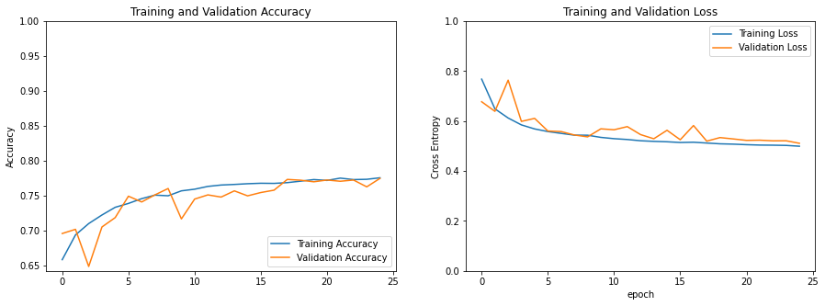
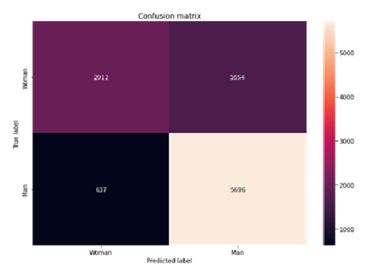
Results & DISCUSSION
Gender Classification
10
Best Model: 77.08%
(Paper: 95%)

Slide 11
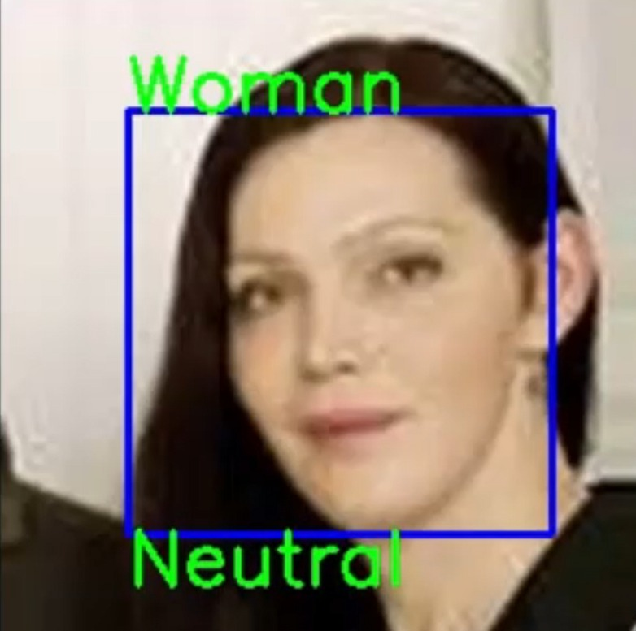
Results & DISCUSSION
Pipeline Results
11
BASIC MODEL
30ms per prediction
RESIDUAL MODEL
20ms per prediction
Speedup of 1.5
10% increase of the detection box leads to better results

Slide 12
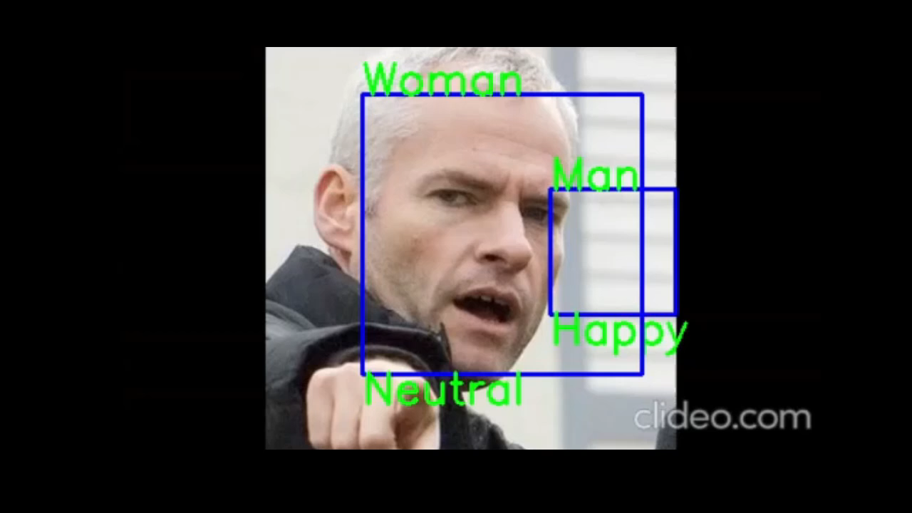
Demonstration
12

Slide 13
References
13
[1] Octavio Arriaga, Paul G. Plöger, and Matias Valdenegro. Real-time Convolutional Neural Networks for Emotion and Gender Classification. Cornell University, https://arxiv.org/pdf/1710.07557.pdf, 2017.
[2] Challenges in Representation Learning: Facial Expression Recognition Challenge. Kaggle, https://www.kaggle.com/competitions/challenges-in-representation-learning-facial-expression-recognition-challenge/overview, 2013.
[3] Rasmus Rothe, Radu Timofte, Luc Van Gool. DEX: Deep EXpectation of apparent age from a single image. International Conference on Computer Vision (ICCV), https://data.vision.ee.ethz.ch/cvl/rrothe/imdb-wiki/, 2015.
[4] OpenCV, Cascade Classifier. https://docs.opencv.org/3.4/db/d28/tutorial_cascade_classifier.html.
[5] Octavio Arriaga, Paul G. Plöger, and Matias Valdenegro, GitHub Face Classification Repository. GitHub, https://github.com/oarriaga/face_classification/tree/b861d21b0e76ca5514cdeb5b56a689b7318584f4, 2017.
[6] Andrew G. Howard et al. Mobilenets: Efficient convolutional neural networks for mobile vision applications. CoRR, abs/1704.04861, https://arxiv.org/pdf/1704.04861.pdf, 2017.

Slide 14
THANK YOU FOR YOUR ATTENTION
14

